Slide 1
A Real Estate Investment Company
Home Selling Guide
Real Estate Agent Partnership Guide
www.buysellrentpropertysolutions.com

Slide 2
Table of Contents
Who Are We?................................................................................................3
Our Mission Statement .................................................................................4
Short & Long Term Renovation Goals…...................................................5-6
Why Contractors Love Working With Us.................................................7-8
Scope of Work……………………………………………………...9-13
Past Projects...…...........................................................................................14-16
Type of Contractor We’re Looking For.....................................................17-18
How We Operate.........................................................................................19-27
Contractor Success Stories..........................................................................28
Taking the Next Steps.................................................................................29

Slide 3
Who Are We?
Buy Sell Rent Property Solutions is a professional, full-service real estate solutions firm that buys and sells properties throughout Georgia. We specialize in buying distressed homes at a significant discount and renovating and reselling them. Founded in 2019, Buy Sell Rent Property Solutions is excited to be part of the area’s renaissance and we aspire to continue contributing to the economic rejuvenation of Georgia communities.
Since its inception, Buy Sell Rent Property Solutions has passionately pursued our goal to help hundreds of people in our community find an answer to their real estate needs. Our organization is proud to be a member of the Better Business Bureau and has been an upstanding member of the Alpharetta, GA area for years.
Important Facts About
Buy Sell Rent Property Solutions
Purchase properties at a discount, renovate quickly and list to resell.
Make CASH offers for houses and create fast, hassle-free transactions in 10 days.
Provide solutions for clients and value for investors by locating and renovating.
COMPANY LEADERSHIP AND TEAM
At Buy Sell Rent Property Solutions, our team is highly motivated, knowledgeable, ethical and resourceful. Qualified to handle any real estate transaction, our dedicated team is committed to helping people with their real estate needs and making successful deals happen. We have the expertise to navigate any transaction and the integrity to follow up on our promises.
We could not achieve our level of success without the many strong partnerships and relationships we have cultivated. At Buy Sell Rent Property Solutions, we place high value on the knowledge and expertise of good real estate agents. We strive to build relationships with qualified, experienced agents who have both a passion for real estate and an uncompromising drive to succeed. We believe that by working together, we will not only develop a history of successful win-win transactions, but also create a powerful and lucrative collaboration that adds value and serves our community.

Slide 4
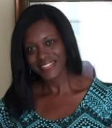
Our Story
Buy Sell Rent Property Solutions is a product of the Premier National Property Investment Training company Fortune Builders. Fortune Builders has been recognized as one of the top 50 Professional Training organizations in the country. Our team is highly motivated, knowledgeable, ethical and resourceful. Qualified to handle any real estate transaction, we are committed to helping people with their real estate needs and making successful deals happen. Our team of professionals has the integrity to follow up on our promises, and the expertise to navigate any transaction to ensure you’re fully informed for making the best decision possible.
Robert Winenger founded the company in 2019 and is passionate about creating change that is positive and beautiful. He enjoys solving challenges with your house or your neighbor's house by having a healthy outlook on every project. Robert enjoys conquering challenges and genuinely connecting with others, inspiring the next generation to be innovative, and promoting great products through online marketing. Robert is a business-savvy management professional with working experience in diverse, fast-paced environments. A strategic risk taker and process improvement champion for developing programs to scale that are effective and robust. A reputation for being demanding and patient while orchestrating change through influence and collaboration. Robert’s true passion lies with his son Tyler, whom he spends much time coaching his four sports and watching him mature as a kind, generous, smart and loving young man.
Brittania is a savvy, motivated, results-oriented professional with 20 years of experience and consulting with real estate professionals all around Atlanta to provide unparalleled, seamless contract management and administrative solutions. As a graduate of Spelman College and having majored in English, she truly enjoys creativity in all things real estate and has a passion for helping her clients grow their real estate business. Learn more to produce more and be open to possibility are her mantras! Her positive energy and spirit enable her to work with many different people and personalities. Her clients affectionately call her “The Real Estate Therapist” because of her ability to calm challenging situations. As a mom of sons 16 and 5 years old, she believes in working hard and sacrificing while maintaining a good career-life balance. Every day is another opportunity to get it right and she uses every chance to be better than the previous day.
Robert Winenger
Founder &
Chief Entrepreneur
Brittania Dennard
Real Estate Consultant

Slide 5
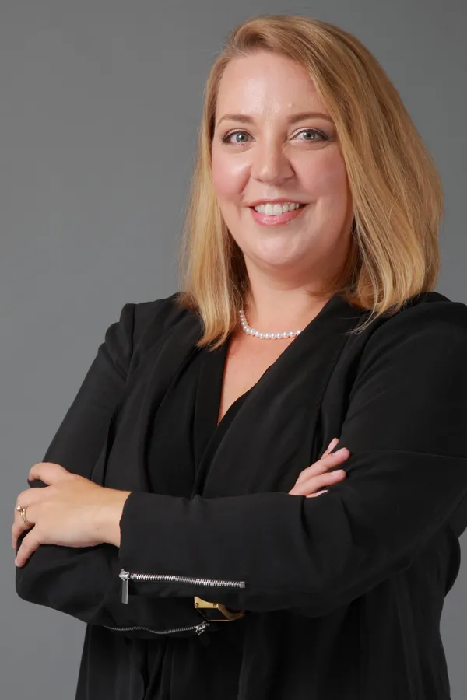
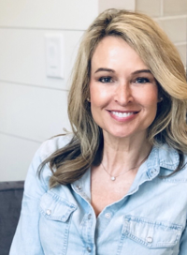
Sales & Acquisition Team
Renee has put her degree in Hospitality and Tourism Management from Virginia Tech to work with Keller Williams Realty for the past seven years. 2019 marks her third year serving on the Agent Leadership Council and assists in the training and development of newer agents. In today's competitive and ever-changing market, Renee's average days on market is 6 with a 98% sales to list price ratio and consistently ranks in the top 20% of Keller Williams Realty. Outside of Real Estate, Renee has been a member of the Junior League of Gwinnett and North Fulton Counties since 2011 and has served on the Board of Directors for the past 4 years. Renee lives in Historic Buford with her two children and crazy dog. She enjoys reading, yoga, travel and hiking.
Nancy has been practicing law for over 14 years. Experienced in both real estate and estate planning matters, she has helped many clients with ranges of legal matters from real estate closings to probate assistance. It is important to Nancy that her clients understand the process and feel empowered in their decisions, while providing excellent legal service to back it up. Nancy earned her Bachelor's degree in Marketing from Penn State University and her Juris Doctor from Georgia State University. She lives in Johns Creek with her husband and two sons. She also volunteers in the community and is an AFAA certified group fitness instructor. Providing excellent service to real estate professionals is a passion of hers.
Susan is a Certified Home Stager and Redesigner. She obtained her Home Staging and Redesign Certification from Home Staging Resources (HSR), has a Bachelor's in Business with Interior Design courses, and an MBA. She is also Color Certified by HSR. Susan is a member of the American Society of Home Stagers and Redesigners. Susan does Home Staging and Design services for various real estate agents, homeowners, and investors in the Atlanta area. She is an entrepreneur and founder of Anew Home Staging & Design. Vacant home staging is her main passion and interest, but she also enjoys choosing design finishings from bathrooms, kitchens, and furniture. Layout, spacial planning, and color are her expertise. She takes great pride in choosing and purchasing all of the furniture and accessories that are used for home staging vacant homes. "My clients' interests are number one to me. I enjoy consulting about each unique home and customizing a design to bring out the best of each home."
Renee Adams
Keller Williams
Realtor
Nancy Wasdin
GA Closing Co.
Attorney
Susan Kilkelly
A New Home Design
Interior Design/Staging

Slide 6
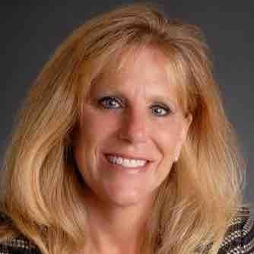
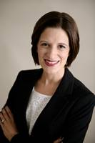
Passive Income Team
Donna brings extensive real estate knowledge and customer care to her clients. Since earning her Georgia Real Estate License in 2006, Donna has displayed a deep commitment to become adept in areas of new construction, general residential resale, residential leasing/property management, and brokerage leadership. Donna’s has grown business through profitability and unit growth nearly double in 2019. Donna is passionate about helping entrepreneurs develop their businesses, and is dedicated to assisting property owners and investors grow the value of their portfolios. In her spare time, she has volunteered for Adopt a Golden Atlanta, Canine Assistance, Kares4Kids, and The Place of Forsyth County. She enjoys her Zumba classes and time at the gym and has a good eye for interior design.
Bio
Donna Hesketh
Atlanta Partners Prop Mgt
Director Property Mgt
Katy Moore
Keller Mortgage
Senior Loan Officer
TBD
Company

Slide 7
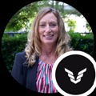
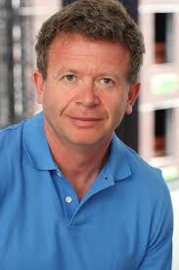
Lending Team
Bio
Bio
Jennifer Moates
Civic Financial
Hard Money Lender
Peter Vekselman
Partner Driven
Private Money Lender
Open
Private Money Lender

Slide 8
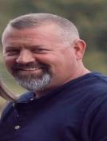
Contractor Team
Travis has 30 years of construction experience and built over 300 homes from Newnan to Fayetteville, GA and Henry county. He opened a roofing and renovation company in January of 2000 and within 6 months was roofing an average of 40 houses per week for multiple Atlanta area builders and had 80 employees. After the real estate crash of 2008, they reroofed over 800 homes between Coweta, Fayette, and Henry county. Currently, his company does an average of 150-300 reroofs every year. In addition, they average 50-74 remodels and additions each year. To complement their construction business, Travis is also a licensed insurance adjuster.
Joel Doyle
Contractor
Atlanta North
Travis LeMay
Contractor
Atlanta South
Greg Bedgood
Contractor
Atlanta East

Slide 9
Contractor Team
Custom Renovation Design Build has been working with homeowners and has a team with over 20 years combined experience in the remodeling trade. Christopher and his team service homeowners in Metro Atlanta. Our company is in the business of helping homeowners realize the true potential of their property through renovations that match their tastes, lifestyles & budget. We specialize in period homes from 1890's to modern new construction. We stand committed to getting the job done with the highest quality workmanship a priority. We pride ourselves also on the quality and reliability of our work and feel that open communication with the homeowner is the best way to exceed your expectations. We provide several references and invite all clients to visit our current and past projects. We do it right the first time because we know in the long run, your unconditional satisfaction is really all that matters.
Sam is the Owner of Torres Homes LLC construction and remodeling company which has provided high-quality building construction services since 1983. It has become recognized as one of the area's most experienced building and remodeling companies. Sam is an accomplished construction leader with expertise in remodeling, offering a wide range of services from concrete to roofing and everything in between. They work regularly with many designers, architects, and engineers as consultants towards each project and provide start-to-finish advice and expertise to enhance and complete any project, regardless of size. Sam is located in Gainesville uniquely situated for easy access to locations throughout Hall, Lumpkin, White, Dawson, Forsyth, and Gwinnett County’s.
Robert Theroux
Contractor
Atlanta West
Christopher Riley
Contractor
Atl Inside Perimeter
Sam Torres
Contractor
North GA

Slide 10
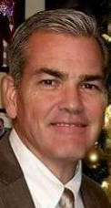
Contractor Team
Bio
Bio
Russell is a retired fireman and officer with a stellar 26-year service record as part of the Gwinnett County Fire Department. He has spent more than 20 years in the construction and remodeling business, focused on rehabbing homes and roof repair in the North GA market. He is also a trained appraiser for residential real estate and brings a wealth of knowledge in assessing home value and ARV.
Luis Peralta
Contractor
Atl Inside Perimeter
Open
Contractor
Location
Russell Lowry
Contractor
North GA

Slide 11
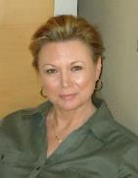
Commercial Team
With over 35 years in the commercial real estate industry, Volesta Autry has extensive experience in leasing, property management, asset management, marketing, budgeting and directing commercial property operations for retail, industrial, office and multi-family properties throughout the country. She was promoted rapidly throughout her career based upon success in improving bottom-line financial results, strengthening management and leasing performance, and solving problems. Volesta is a licensed real estate broker in Georgia, Alabama, and Florida and has a wide range of knowledge and experience in land brokerage, site selection, and consulting for commercial property owners and developers.
A seasoned, high-energy leader with a strong record of success in building marketing and sales organizations, cultivating key account relationships, developing sales skills in new hires, and delivering revenue results. Highly regarded for exceptional business acumen and outstanding consultative sales skills with C-suite prospects at Fortune 500 companies…specializing in multi-unit Apartment Complexes. Excels at educating the marketplace on the value of implementing complex, robust technology products offering substantial ROI benefits. Decisive and engaging with a fierce determination to succeed; proven success in empowering and leading teams that meet and exceed goals.
Emily is ready to get to work to find the right home for you! She is a licensed real estate agent with Ansley Atlanta helping buyers and sellers in their real estate journey – whether you’re looking to buy a condo in a hip, intown neighborhood or sell a more traditional family home OTP. She loves her home and wants you to love yours too! Contact me to discuss your unique needs.
Volesta Autry
Commercial Real Estate Broker, Treadstone
Mary Beth Breen
Passive Income-
Multi-Unit Specialist
Emily Wheeler
Realtor, Off-Market &
Wholesale Specialist

Slide 12
Preferred Vendors
Dave Hess
Pro Manager
Home Depot
Home Depot - Hardware and Supplies
Paint
Landscape
Retaining Walls
Countertops
Flooring
Siding
Roof
Drywall
Sun
Sales
Sherwin Williams
Eddie Lee
Owner
Lawn Ninja
Justino Castanon
Owner
Stone Co.
James
Owner
Pro Countertops
Open
Owner
Pro Countertops
Open
Owner
Pro Countertops
Open
Owner
Pro Countertops
Open
Owner
Pro Countertops

Slide 13
Our Mission
When a passion for real estate is combined with talented individuals who have an uncompromising drive to succeed, amazing things will happen. At Buy Sell Rent Property Solutions, it’s our goal to not only have a positive effect on our families, and ourselves but also to inspire, motivate and create lasting change in everyone we encounter. We will treat our clients and team members with respect at all times. Our company will dedicate itself to everlasting education and professional growth that will make the leaders of tomorrow.

Slide 14
Short & Long Term Goals
As well-established real estate professionals, we are in this business for the long haul. We place a high priority on developing long-term relationships with our customers and real estate agents so that we all achieve our goals.
SHORT TERM GOALS
Our short term goal is to aggressively expand the presence of our business in surrounding markets. Each year for the past 10 years we have surpassed our residential redevelopment goals. Our current annual projection is to renovate three or more homes a month and acquire a new rental property. Rehab budgets on our projects range anywhere from $5,000 on a rental property to $250,000 on a full rehab. Typical project timeframes generally run from 3-6 months. Our goal is to turn around our projects at a rapid pace so we can get paid as quickly as possible and use those profits to immediately start on the next rehab. This ensures that we and our contractor teams have a steady supply of work.
Our 5-10 Year Vision
Continue our annual residential redevelopment program.
Pursue commercial projects such as apartment building acquisitions and land development. With our management skills and background in the development industry, our natural progression will expand us into the community-development arena.
Purchase small tracts of land and develop residential communities throughout Georgia. To accomplish this long-term goal, it will be imperative that we develop strong relationships with real estate agents who have a like-minded goal of expansion.
LONG TERM GOALS
Our long term goal is to grow our operations into multiple target markets across the country in the coming years.
What this means for you is we will create a growing stream of projects for real estate partners to work on long into the future.
INVESTMENT & REDEVELOPMENT STRATEGY
Our business strategy—which has proven to be very successful for us—is to purchase undervalued 1-8 unit residential properties, renovate them to a highly desirable condition, and sell these properties directly to single-family homebuyers or investors as quickly as possible after completion.

Slide 15
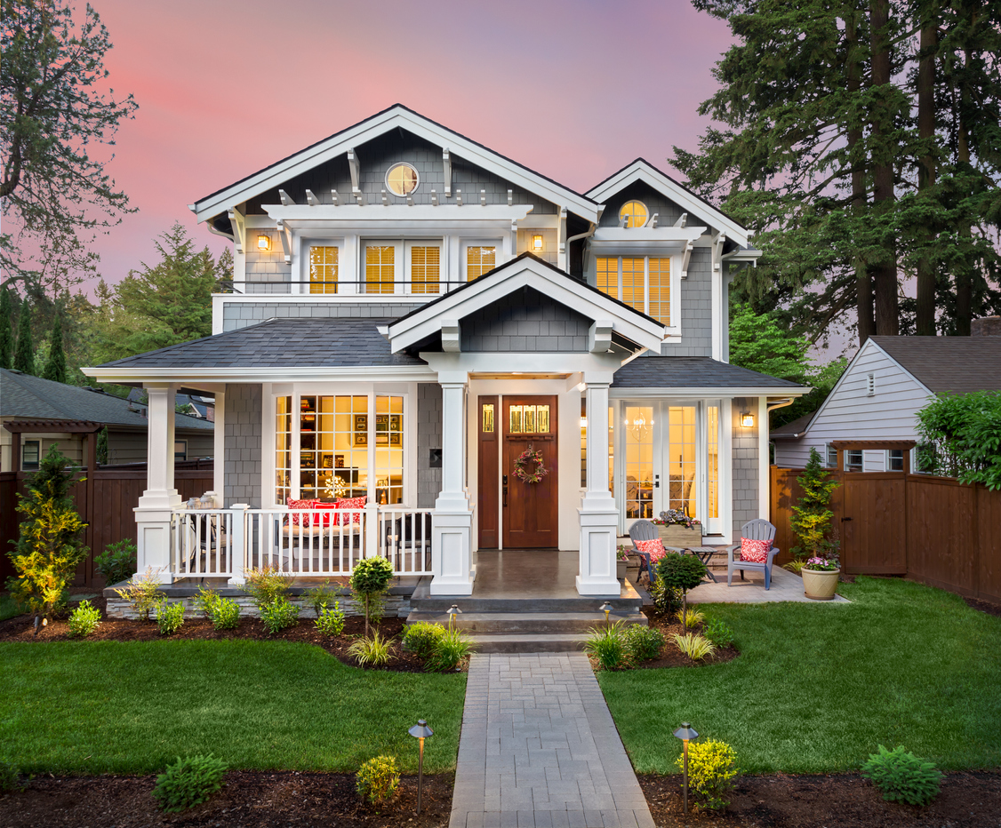
Short & Long Term Goals
To generate value, we focus on aggressive project management coupled with the use of highly skilled and professional independent contractors to complete our renovations. In addition, we employ proactive marketing tactics to pre-sell our properties during the rehab stage instead of waiting until the project is complete. This gives us a head start that often enables us to sell our properties before the paint has even dried on them. Successful execution of these strategies rely on the high quality of work performed by our contractors, which is why we put such a high premium on finding the best contractors in the area and then developing long-term, mutually beneficial win-win relationships.
Why Our Model Works
Speed and efficiency in the rehab process
Quality of workmanship
Community appreciation
Mutual respect for everyone’s time involved
Integrity of product delivered to the marketplace
Community vision
We actively strive to increase homeownership opportunities within the communities we redevelop, and improve the quality of life for the people who live in them by providing quality homes for a reasonable price.

Slide 16
Why Real Estate Agents Love Working With Us
We work hard to create positive and productive mutually beneficial relationships with our affiliated businesses. Here are just a few of the benefits of working with Buy Sell Rent Property Solutions:
CASH OFFERS
QUICK CLOSING
WE BUY HOUSES AS IS
NO APPRAISALS
NO LENDING RESTRICTIONS
WE DON’T SUBMIT LOW OFFERS
WE WAIT ON SHORT SALE APPROVALS
BBB ACCREDITED
As an agent, you can take advantage of many unique opportunities when it comes to working with investors. Here is a list of how we compare to a traditional buyer:
GAIN REPEAT BUSINESS
One of the main benefits of working with an investor is the potential for repeat business throughout the course of a year. By working consistently with a successful investor who actively buys and sells properties, you can predict a steady revenue stream based on their level of activity. Although it varies, most real estate agents typically close between 2 to 10 deals per year with investors. Many leverage those deals into even more deals, just by working with the buyers who purchase investment properties.
 | Traditional Buyer | Pike Properties
Method of Payment | Bank Financing | CASH
Cost of Repairs | 1-8% of Homes Value | None (Bought AS-IS)
Closing Timeframe | 45+ Days | 10-14 Days
Amount of Business For You | Typically only one purchase | Repeat Buyers (2-10 deals per yr)
Repairs Needed | Repairs, no matter how big or small are important to owner occupants – often times, making it difficult to find a house quickly & make the sale | We look for homes that are not perfect and need improvements
Appraisal | Mandatory | None
Re-Listing the Home | Years down the road | 2-4 Months on Average

Slide 17
Benefits of Working With Us
OPPORTUNITY TO MAKE BOTH SIDES OF COMMISSION
By acting as a dual agent in a transaction, representing both the buyer and seller, you can earn both sides of the commission. For example, let’s say that you as a licensed agent have an REO property listed. Our goal is for the agents we work with to be excited to work with us which is why we’re happy for you if you received both sides of the commission.
Become a Distressed Property Specialist
There are a number of properties in the marketplace needing renovations – anything from cosmetic repairs to full-gut rehabs. Often times, you as the agent are the first contact for sellers behind on payments, who need to sell quickly, or don’t have equity in their home. These are exactly the types of opportunities we are looking for. If you or someone in your office have these types of listings, we may be able to quickly purchase the homes with CASH. After a few successful transactions, you can utilize that success to gain more exposure in your market and build your credibility as a distressed property specialist – ultimately, increasing your income opportunity.
Access to Property Inventory Before Listed
A successful and active investor will constantly have an inventory of completely renovated properties; and YOU will have access to that inventory BEFORE that property is listed on the MLS. This creates a great opportunity for buyers – especially a first-time homebuyer, as they would have the chance to purchase a newly renovated and fairly priced property. In some cases, your buyers can also have the benefit of giving input on certain features of their home and choosing custom finishes BEFORE renovations are fully complete. By providing this option to your buyer, it completely differentiates you from other agents – therefore, directly impacting your bottom-line!
What’s In It For You?
Opportunity to make double commission
Consistent business (we buy 24-36 properties a year)
Obtain referral leads
Access to property inventory before listed
Opportunity to host open houses
Short sale referrals
Ease of transactions – we use electronic signatures
Become a distressed property specialist in your area
Free training & joint venture potential
Enhance your profile as an agent in your community

Slide 18
Benefits of Working With Us
OPPORTUNITY TO HOST OPEN HOUSES
Newly renovated vacant properties generate a lot of interest from potential buyers – like a neighbor or anyone else looking for properties priced aggressively and in pristine condition. By acting as a seller’s agent, this creates a great opportunity to host open houses for these properties; allowing you to meet many new potential buyers that you can add to your database, and possibly cultivate as buyer clients of your own.
Short Sale Referrals
Successful investors are excellent marketers and generate a lot of leads – many of which are short sales. In most cases, investors aren’t too interested in working with sellers whose properties are over-leveraged and in short sale situations. The short sale process can be lengthy, so many investors prefer to refer those leads to a specialist rather than work with the sellers themselves. This creates a huge opportunity for you to become a “short sale specialist” – by listing these properties and getting the commission when they sell. As a short sale specialist, you also have the opportunity of working with multiple investors, which provides you with more of an revenue stream ten fold!
Become a Part Of our Team!
In working with us, there are several benefits and different ways you can generate revenue:
Represent Us As Our Buyer's Agent
We Are CASH Investors & Buy 24-36 Properties A Year
Represent Us As Our Listing Agent
Re-List Our Fully Renovated Vacant Properties In Your Area
Be Our Referral Agent
Tap Into Our List of Buyer, Seller & Short Sale Leads
Generate Buyers Via Open Houses
Market our “Pocket” Listings
Although many of our offers will be typically lower than retail clients, we serve as a great benefit for hard-to-sell properties or those requiring the bank or seller to move quickly. We are also a good fit if you have listings that have difficulty qualifying for traditional financing based on the current condition of the property. We are not the perfect fit for everyone; but for the seller with the right motivation, these features are a necessity.

Slide 19
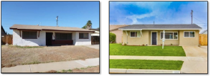
Sample Scope of Work
Scope of Work - Single Family
PROJECT INTRODUCTION & INTERVIEW:
Gorgeous renovation in the central neighborhood of El Cajon. This 3BR, 2 BA 1 story home is located near Granite Hills High and Wells Park.
REHAB OVERVIEW:
The home needed a few cosmetic repairs and updates throughout including kitchen and master bath. Electrical plumbing upgrades were completed as needed to comply with close regulations.
CONTRACTOR OVERVIEW:
Licensed contractors were hired to complete all renovations.
DEMO (EXTERIOR):
Remove all debris in front and back yard
Remove roof from covered patio (use structure to create pergola)
Remove temporary roof over side yard
Remove lighting from covered patio
GENERAL (EXTERIOR):
Construct 4’ fence around pool equipment
Build pergola off of existing covered patio structure
Paint entire house per color scheme
COLOR | LOCATION | COLOR CODE | FINISH
Valspar/Lowes Stone Manor | Exterior | 6006-2A | Flat
Extra White Sherwin Williams | Exterior Trim | 7006 | Flat
Black | Front Door/Pergola
Extra White (Sherwin Williams) | All ceilings | 7006 | Flat
Navajo White (Sherwin Williams) | Bathrooms | SW 6126 | Semi Gloss
Navajo White (Sherwin Williams) | Living/Dining/Halls, Laundry, Kitchen, Bedrooms | SW 6126 | Flat

Slide 20
Sample Scope of Work
ROOF:
Remove existing roof
Replace any damaged sheeting or starter board
Install new 15 lbs felt paper
Install new dimensional composite shingle roof (charcoal color)
Paint all roof penetrations black
LANDSCAPE:
Removal all debris in front and back yard
Removal all weeds in front and back yard
Install sod in the front and back yard
Cut in planter boxes next to house and fence in front and back yard and plant drought tolerant plants
Test irrigation system and repair where needed or install one in front yard
WINDOWS:
Replace all windows with retro fit insert windows
Replace all sliders with retro fit
DEMO (INTERIOR):
Remove all trash in house
Demo kitchen and remove cabinets
Demo existing bathroom toilet, vanity, tile floor and shower surround
Remove all tile flooring
Scrape popcorn ceiling
Remove all window coverings
Do not damage wood floor as we are keeping it (install rosin paper to protect flooring)
GENERAL (INTERIOR):
Construct new bathroom where existing bedroom is (see layout)
Construct new stackable laundry closet in hallway (see layout)
Change all door hinges and hardware with brush nickel
Retexture ceiling
Install new ceiling fans in all bedrooms
Combine both back bedrooms to create large master suite (see layout)
Close off door to existing bathroom and construct new door going into master suite (see layout)
Change front door hardware - Home Depot #640-064 $169

Slide 21
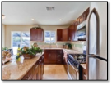
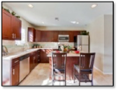
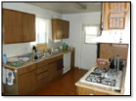
Sample Scope of Work
KITCHEN:
Install backsplash - DalTile Travertine 3”x6” honed $6.11/sq ft #T711361U (installed subway style and to the bottom of the cabinets)
Install backsplash accent tile 4” strip – DalTile American Olean Legacy Glass Celedon 2”x2” LG03
Install new stainless steel appliances
A. Frigidaire FFFTR2126LS 21 CF Top Freezer Refrigerator - $625.00
B. Frigidaire FFFMV162LS 1.6 CF 1,000 Watt Range Microwave - $269.00
C. Frigidaire FFFBD2406NS 24” Built in Dishwasher - $295.00
D. Frigidaire FFFGF3047LS 30” Free Standing Gas Range - $556.00
Install new faucet - Proflo PFXC8011BN Single Handle Kitchen Faucet w/ Pullout Spray (Low Lead Compliant) - $180.65
Install new countertops – Rainbow Stone “New Venetian Gold” Granite
Install new cabinets – Home Depot American Classics Harvest Finish
Install 4 recessed lights
Paint as per color scheme
HALL BATH:
Install new vanity (espresso finish)
New Faucet - Grohe G20209002 “Eurostyle Cosmopolitan” 8’’ Widespread Bathroom Sink Faucet - $160.10
New toilet (Elongated Bowl)
New tub - Sterling S610411100 “ALL Pro” 60” Soaking Tub – 128.90
Shower head and trim kit - Grohe G26017000 “ BauLoop” Tub & Shower Faucet Trim - $130.95
New shower valve - Grohe G35015000 Tub & Shower Valve - $67.50
Install Tile surround – DalTile Rittenhouse Square 3”x6” Matte Almond $2.70/sq ft #X735 (installed subway style, tile to ceiling)
Accent Tile 12” Strip – DalTile Stone Radiance Whisper Green Blend (installed roughly 5” up the wall)
Tile floor – DalTile Travertine 18” x18” Honed $1.99/sq ft (installed subway style)

Slide 22
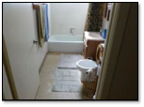
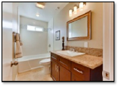
Sample Scope of Work
MASTER BATH:
New toilet (Elongated Bowl)
New tub – Home Depot #693-952 $209
Install new vanity (espresso finish)
Tub spout - Grohe G13611000 “Eurodisc” Tub Spout - $14.65
New Faucet - Grohe G20209002 “Eurostyle Cosmopolitan” 8’’ Widespread Bathroom Sink Faucet -$160.10
Install Rain shower head and regular showerhead - Moen MS6360 2.5 GPM Flat Rain Showerhead -$125.10 & Grohe G19595000 “ BauLoop” Shower Head with Trim Kit - $47.25
Install 2 new shower valves - Grohe G35015000 Tub & Shower Valve - $67.50
Install Tile Surround - DalTile Fabric 12”x24” $3.70/sq ft #P687 (Installed subway style, tile to ceiling and tile ceiling)
Accent Tile on control wall – DalTile Class Reflections Subway Mint Jubilee 3”x6” 9.06/sq ft #GR15 (installed subway style)
Tile back splash behind mirror to ceiling - DalTile Class Reflections Subway Mint Jubilee 3”x6” $9.06/sq ft #GR15 (installed subway style)
Tile floor- DalTile Veranda 13”x13” Dune $3.70/sq ft (installed subway style)
BEDROOMS:
Install slab closet doors (make sure they are hallow core interior doors converted to closet doors, install ceiling and floor track as well as hardware
Lighting – Home Depot Hampton Bay 2- Light Flush mount With Opal Glass, #534-435, $39.97/ea
PLUMBING:
Check all existing plumbing & repair/replace as needed, per code
New angle stops on all water lines
Check gas lines & repair/replace as needed
Check all drain lines & repair/replace as needed
ELECTRICAL:
Replace all outlets & switches
Check all wiring & replace where needed, per code
Install recessed lighting as per drawing
Check panel & repair/replace as needed
Install Dead Panel if missing
Check for open junction point in attic
HVAC:
1. Inspect and repair as needed

Slide 23
Sample Scope of Work
COMPLETION OF FINAL PUNCH LIST:
General Contracting Work - $33,300.00
All framing, counters, cabinets, paint and patch. fixtures, backsplash, windows and doors.
Appliances - $2,000.00
Stainless steel refrigerator, free standing range, hood and over the range microwave, dishwasher
Electrical - $2,750.00
Install new fixtures; add recessed lighting, replace outlets and switches, panel upgrade
Plumbing - $6,500.00
Install new toilets, facets, shower valves, kitchen sink, garbage disposal, dishwasher, add tub and shower
Landscaping - $2,000.00
Flooring - $1,850.00
Roofing - $4,500.00
Staging (2 month minimum contract) - $1,500.00
Misc. and Permits - $1,500.00
TOTAL - $55,900

Slide 24
Past Projects
A real estate renovation company earns its reputation based on the past projects completed. Every project plays an important part in setting and maintaining the high standards we want associated with our properties. We set high standards for our contractors, enabling us to consistently deliver the best housing products possible to our customers at a fair price. In the pages that follow, you will see a few of our past projects to get a better understanding of our quality expectations. Our goal is to create a product we can replicate over and over again.
EXAMPLE 1: (INSERT PROPERTY ADDRESS HERE)
BEFORE AFTER
INSERT
“BEFORE” PHOTO HERE
INSERT
“AFTER” PHOTO HERE
INSERT
“BEFORE” PHOTO HERE
INSERT
“AFTER” PHOTO HERE
INSERT
“BEFORE” PHOTO HERE
INSERT
“AFTER” PHOTO HERE

Slide 25
Past Projects
EXAMPLE 2: (INSERT PROPERTY ADDRESS HERE)
BEFORE AFTER
INSERT
“BEFORE” PHOTO HERE
INSERT
“AFTER” PHOTO HERE
INSERT
“BEFORE” PHOTO HERE
INSERT
“AFTER” PHOTO HERE
INSERT
“BEFORE” PHOTO HERE
INSERT
“AFTER” PHOTO HERE

Slide 26
Past Projects
EXAMPLE 3: (INSERT PROPERTY ADDRESS HERE)
BEFORE AFTER
INSERT
“BEFORE” PHOTO HERE
INSERT
“AFTER” PHOTO HERE
INSERT
“BEFORE” PHOTO HERE
INSERT
“AFTER” PHOTO HERE
INSERT
“BEFORE” PHOTO HERE
INSERT
“AFTER” PHOTO HERE

Slide 27
Frequently Asked Questions
will i be required to spend a lot of time driving around showing you properties to buy?
No, not at all! We already know what we’re looking for, and our criteria typically stay the same. While we may need you to let us inside a property once in a while, we wouldn’t ask you to spend your time on wild goose chases.
is it worth my time to work with an investor?
Yes! You can automate most of the process so you’re not wasting your time on working on tedious tasks. By working with an investor, you create a very lucrative source of income as well. In a partnership with us, you can earn multiple commissions by representing us as both the buyers and sellers agents.
What kinds of offers do investors usually make?
Our offers are in cash. They are below retail, but they are also highly valuable because they are cash offers. Some of our offers do get rejected; but, unlike traditional clients who may buy or sell a home once every five years, we make multiple transactions annually.
how can i work with pike properties?
You have the opportunity to become what we call a “triple agent.” When working with Pike Properties, you can act as the buyers agent, the listing agent and the referral agent. In other words, you may be able to earn triple commission on a single deal. Secondly, we will actively send you leads on listings and give you the right to generate more leads by marketing our homes once the renovations are complete. We can also will send buyers to you.
What types of properties do you purchase from sellers?
We purchase homes in pre-foreclosure, over-leveraged, condemned, liens or health department violations, not maintained, fire damaged, estate sales, stagnant listings, even about to fall down homes - we can buy it!
.

