Slide 1
Home Selling Guide
A Real Estate Solutions Company
www.buysellrentpropertysolutions.com

Slide 2
A Real Estate Solutions Company
Buy Sell Rent Property Solutions is the Greater Atlanta area’s premier real estate solutions company located in Alpharetta, GA. The company specializes in solving complicated real estate matters for people throughout the state. Since its inception, the company has helped hundreds of homeowners find solutions to their complicated real estate problems. Whether the homeowner is looking to stay in the home or sell, we can provide a quick and easy solution. The company specializes in foreclosure avoidance and is the foremost expert in this arena. We can help stop the foreclosure and avoid bankruptcy in most scenarios. We work with each homeowner individually and explore all possible options.
Real Estate Specialties
Foreclosure Avoidance
Debt Removal or Renegotiation
Refinancing Homes in Foreclosure
Sell your Property without Realtor Commissions
Title Issues
Relocation Assistance
Vacant Properties
Environmental or Structural Problems
Apartment & House Rental Specialists
Bankruptcy
Overleveraged Properties
Judgments or Outside Liens
Credit Repair
First Time Homebuyer Programs
Additionally, the company has helped numerous families achieve the dream of home ownership through its first time home buyer educational program and credit repair program. Buy Sell Rent Property Solutions is proud to be part of the area’s renaissance and we aspire to continue contributing to the economic rejuvenation of Georgia.
Buy Sell Rent Property Solutions is a member of the Better Business Bureau and has been an integral part of the community for years. We can provide numerous references from past clients upon request. Call us today and we can discuss your options!
Buy Sell Rent Property Solutions
5975 Shiloh Road Ste 107
Alpharetta, GA 30005
770-695-7565
Robert@BuySellRentPropertySolutions.com
www.BuySellRentPropertySolutions.com

Slide 3
A Real Estate Solutions Company
Purchase Program
If saving In many instances, it may be in your best interest to sell. If you are struggling to make the mortgage payment each month, you may need want to find a more affordable situation. Likewise, do not risk losing valuable equity to a pending foreclosure by not taking action. We can purchase your home directly from you and there are no hefty realtor commissions you will have to pay. We can also close very quickly or on your timeline, whatever you prefer. Call us today and we can make you an offer in less than 24 hours!
Mortgage Refinance Programs
If saving your home is your goal, we can help! We work with many national lenders who specialize in refinancing homeowners who are behind on payments. Most mortgage companies will shy away from borrowers with tarnished credit, but not the lenders we work with. We will work diligently to find the best loan product for you. If this program interests you, please speak with us today because the longer you delay the more difficult it will be to qualify!
Loan Modification Programs
A “Loan Modification Program” is a special program designed to help homeowners who had a previous hardship get back on track with their mortgage. We will work directly with you and your lender to help you qualify, however you must have recovered from that hardship, and be able to make your mortgage payments again. Often times the lender will require some sort of partial payment before they will consider a loan modification program. The relationships we have built with many banks will help you immensely during this process.
Short Sale Programs
With today’s declining real estate market it can be very difficult for some homeowners to sell their property. If you are overleveraged you may be tempted to just walk away, however this is not in your best interest. There are serious consequences if you let the home go to foreclosure. If this is a scenario you are currently experiencing you must understand you have options. We are very successful at negotiating debt with banks and can often times purchase your property directly from you thus saving you from a foreclosure.
Credit Repair Programs
Whether you are looking to repair your credit
from an unfortunate financial event or improve
your credit score in order to purchase another
home in the future, our network of credit repair
specialists can produce results quickly. We can
provide educational materials, step by step
instruction, and professional credit coaching.
Buy Sell Rent Property Solutions
5975 Shiloh Road Ste 107
Alpharetta, GA 30005
770-695-7565
Robert@BuySellRentPropertySolutions.com
www.BuySellRentPropertySolutions.com

Slide 4
A Real Estate Solutions Company
Homeowner Relocation Program
We realize the challenges homeowners face when selling their property. That is why Buy Sell Rent Property Solutions created the Homeowner Relocation Program and will work hand in hand with you to locate another home or an apartment depending on your needs. We can also arrange for movers if this is something you desire. We know selling a home can be stressful and believe in going the extra mile for our customers. Please inquire about the program and let us help you with your transition.
Company Testimonials
“Being in the mortgage business I know how complicated home transactions can be and that is why I have been so impressed with the way you does business. I have seen them solve some of the most difficult real estate problems that other investors and real estate professionals would not touch. They are extremely professional and most importantly do what they promise. If you are looking to refinance, sell, or buy a home I would deal with them first!”
- Tom Wicker, Mortgage Broker
“I had a very complicated Real Estate problem whereby I owed much more than my house was worth and as a result could not sell my property. You actually negotiated my debt down with my mortgage company and were able to purchase my house thus saving me from foreclosure.”
- Chris C. , Home Seller
“I can not thank your company enough for helping me solve my real estate problems. I was behind on my mortgage and need someone to close quickly. The company actually made up all of my back payments and continued to pay my mortgage which has helped me re-establish my credit. I can not thank you enough.”
- Jennifer L. Home Seller
“As a Real Estate attorney I deal with many difficult real estate closings and I have been extremely impressed with the way you have helped solve many of my client’s real estate problems. I extend my sincere gratitude to your company for your professionalism during our ongoing professional relationship.”
- Francis Lieto, Attorney
“Thank you very much for everything. Your
company was very professional and you did
everything you said you were going to.”
- Nicole Wade, Home Seller
Buy Sell Rent Property Solutions
5975 Shiloh Road Ste 107
Alpharetta, GA 30005
770-695-7565
Robert@BuySellRentPropertySolutions.com
www.BuySellRentPropertySolutions.com

Slide 5
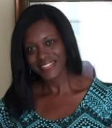
Our Story
Buy Sell Rent Property Solutions is a product of the Premier National Property Investment Training company Fortune Builders. Fortune Builders has been recognized as one of the top 50 Professional Training organizations in the country. Our team is highly motivated, knowledgeable, ethical and resourceful. Qualified to handle any real estate transaction, we are committed to helping people with their real estate needs and making successful deals happen. Our team of professionals has the integrity to follow up on our promises, and the expertise to navigate any transaction to ensure you’re fully informed for making the best decision possible.
Robert Winenger founded the company in 2019 and is passionate about creating change that is positive and beautiful. He enjoys solving challenges with your house or your neighbor's house by having a healthy outlook on every project. Robert enjoys conquering challenges and genuinely connecting with others, inspiring the next generation to be innovative, and promoting great products through online marketing. Robert is a business-savvy management professional with working experience in diverse, fast-paced environments. A strategic risk taker and process improvement champion for developing programs to scale that are effective and robust. A reputation for being demanding and patient while orchestrating change through influence and collaboration. Robert’s true passion lies with his son Tyler, whom he spends much time coaching his four sports and watching him mature as a kind, generous, smart and loving young man.
Brittania is a savvy, motivated, results-oriented professional with 20 years of experience and consulting with real estate professionals all around Atlanta to provide unparalleled, seamless contract management and administrative solutions. As a graduate of Spelman College and having majored in English, she truly enjoys creativity in all things real estate and has a passion for helping her clients grow their real estate business. Learn more to produce more and be open to possibility are her mantras! Her positive energy and spirit enable her to work with many different people and personalities. Her clients affectionately call her “The Real Estate Therapist” because of her ability to calm challenging situations. As a mom of sons 16 and 5 years old, she believes in working hard and sacrificing while maintaining a good career-life balance. Every day is another opportunity to get it right and she uses every chance to be better than the previous day.
Robert Winenger
Founder &
Chief Entrepreneur
Brittania Dennard
Real Estate Consultant

Slide 6
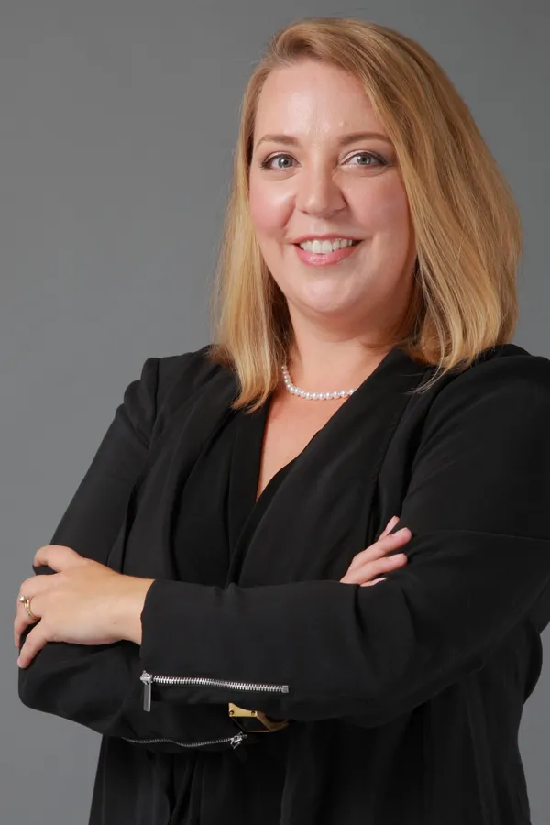
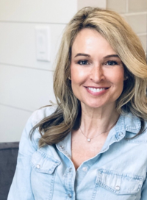
Sales & Acquisition Team
Renee has put her degree in Hospitality and Tourism Management from Virginia Tech to work with Keller Williams Realty for the past seven years. 2019 marks her third year serving on the Agent Leadership Council and assists in the training and development of newer agents. In today's competitive and ever-changing market, Renee's average days on market is 6 with a 98% sales to list price ratio and consistently ranks in the top 20% of Keller Williams Realty. Outside of Real Estate, Renee has been a member of the Junior League of Gwinnett and North Fulton Counties since 2011 and has served on the Board of Directors for the past 4 years. Renee lives in Historic Buford with her two children and crazy dog. She enjoys reading, yoga, travel and hiking.
Nancy has been practicing law for over 14 years. Experienced in both real estate and estate planning matters, she has helped many clients with ranges of legal matters from real estate closings to probate assistance. It is important to Nancy that her clients understand the process and feel empowered in their decisions, while providing excellent legal service to back it up. Nancy earned her Bachelor's degree in Marketing from Penn State University and her Juris Doctor from Georgia State University. She lives in Johns Creek with her husband and two sons. She also volunteers in the community and is an AFAA certified group fitness instructor. Providing excellent service to real estate professionals is a passion of hers.
Susan is a Certified Home Stager and Redesigner. She obtained her Home Staging and Redesign Certification from Home Staging Resources (HSR), has a Bachelor's in Business with Interior Design courses, and an MBA. She is also Color Certified by HSR. Susan is a member of the American Society of Home Stagers and Redesigners. Susan does Home Staging and Design services for various real estate agents, homeowners, and investors in the Atlanta area. She is an entrepreneur and founder of Anew Home Staging & Design. Vacant home staging is her main passion and interest, but she also enjoys choosing design finishings from bathrooms, kitchens, and furniture. Layout, spacial planning, and color are her expertise. She takes great pride in choosing and purchasing all of the furniture and accessories that are used for home staging vacant homes. "My clients' interests are number one to me. I enjoy consulting about each unique home and customizing a design to bring out the best of each home."
Renee Adams
Keller Williams
Realtor
Nancy Wasdin
GA Closing Co.
Attorney
Susan Kilkelly
A New Home Design
Interior Design/Staging

Slide 7
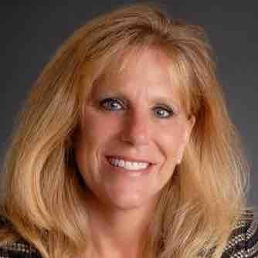
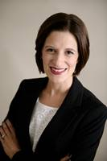
Passive Income Team
Donna brings extensive real estate knowledge and customer care to her clients. Since earning her Georgia Real Estate License in 2006, Donna has displayed a deep commitment to become adept in areas of new construction, general residential resale, residential leasing/property management, and brokerage leadership. Donna’s has grown business through profitability and unit growth nearly double in 2019. Donna is passionate about helping entrepreneurs develop their businesses, and is dedicated to assisting property owners and investors grow the value of their portfolios. In her spare time, she has volunteered for Adopt a Golden Atlanta, Canine Assistance, Kares4Kids, and The Place of Forsyth County. She enjoys her Zumba classes and time at the gym and has a good eye for interior design.
Bio
Donna Hesketh
Atlanta Partners Prop Mgt
Director Property Mgt
Katy Moore
Keller Mortgage
Senior Loan Officer
TBD
Company

Slide 8
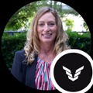
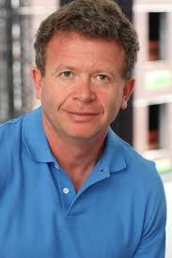
Lending Team
Bio
Bio
Jennifer Moates
Civic Financial
Hard Money Lender
Peter Vekselman
Partner Driven
Private Money Lender
Open
Private Money Lender

Slide 9
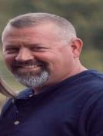
Contractor Team
Travis has 30 years of construction experience and built over 300 homes from Newnan to Fayetteville, GA and Henry county. He opened a roofing and renovation company in January of 2000 and within 6 months was roofing an average of 40 houses per week for multiple Atlanta area builders and had 80 employees. After the real estate crash of 2008, they reroofed over 800 homes between Coweta, Fayette, and Henry county. Currently, his company does an average of 150-300 reroofs every year. In addition, they average 50-74 remodels and additions each year. To complement their construction business, Travis is also a licensed insurance adjuster.
Joel Doyle
Contractor
Atlanta North
Travis LeMay
Contractor
Atlanta South
Greg Bedgood
Contractor
Atlanta East

Slide 10
Contractor Team
Custom Renovation Design Build has been working with homeowners and has a team with over 20 years combined experience in the remodeling trade. Christopher and his team service homeowners in Metro Atlanta. Our company is in the business of helping homeowners realize the true potential of their property through renovations that match their tastes, lifestyles & budget. We specialize in period homes from 1890's to modern new construction. We stand committed to getting the job done with the highest quality workmanship a priority. We pride ourselves also on the quality and reliability of our work and feel that open communication with the homeowner is the best way to exceed your expectations. We provide several references and invite all clients to visit our current and past projects. We do it right the first time because we know in the long run, your unconditional satisfaction is really all that matters.
Sam is the Owner of Torres Homes LLC construction and remodeling company which has provided high-quality building construction services since 1983. It has become recognized as one of the area's most experienced building and remodeling companies. Sam is an accomplished construction leader with expertise in remodeling, offering a wide range of services from concrete to roofing and everything in between. They work regularly with many designers, architects, and engineers as consultants towards each project and provide start-to-finish advice and expertise to enhance and complete any project, regardless of size. Sam is located in Gainesville uniquely situated for easy access to locations throughout Hall, Lumpkin, White, Dawson, Forsyth, and Gwinnett County’s.
Robert Theroux
Contractor
Atlanta West
Christopher Riley
Contractor
Atl Inside Perimeter
Sam Torres
Contractor
North GA

Slide 11
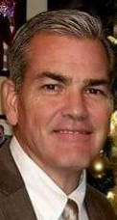
Contractor Team
Bio
Bio
Russell is a retired fireman and officer with a stellar 26-year service record as part of the Gwinnett County Fire Department. He has spent more than 20 years in the construction and remodeling business, focused on rehabbing homes and roof repair in the North GA market. He is also a trained appraiser for residential real estate and brings a wealth of knowledge in assessing home value and ARV.
Luis Peralta
Contractor
Atl Inside Perimeter
Open
Contractor
Location
Russell Lowry
Contractor
North GA

Slide 12
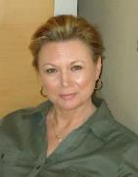
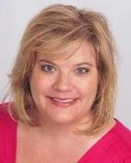
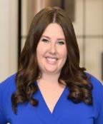
Commercial Team
With over 35 years in the commercial real estate industry, Volesta Autry has extensive experience in leasing, property management, asset management, marketing, budgeting and directing commercial property operations for retail, industrial, office and multi-family properties throughout the country. She was promoted rapidly throughout her career based upon success in improving bottom-line financial results, strengthening management and leasing performance, and solving problems. Volesta is a licensed real estate broker in Georgia, Alabama, and Florida and has a wide range of knowledge and experience in land brokerage, site selection, and consulting for commercial property owners and developers.
A seasoned, high-energy leader with a strong record of success in building marketing and sales organizations, cultivating key account relationships, developing sales skills in new hires, and delivering revenue results. Highly regarded for exceptional business acumen and outstanding consultative sales skills with C-suite prospects at Fortune 500 companies…specializing in multi-unit Apartment Complexes. Excels at educating the marketplace on the value of implementing complex, robust technology products offering substantial ROI benefits. Decisive and engaging with a fierce determination to succeed; proven success in empowering and leading teams that meet and exceed goals.
Emily is ready to get to work to find the right home for you! She is a licensed real estate agent with Ansley Atlanta helping buyers and sellers in their real estate journey – whether you’re looking to buy a condo in a hip, intown neighborhood or sell a more traditional family home OTP. She loves her home and wants you to love yours too! Contact me to discuss your unique needs.
Volesta Autry
Commercial Real Estate Broker, Treadstone
Mary Beth Breen
Passive Income-
Multi-Unit Specialist
Emily Wheeler
Realtor, Off-Market &
Wholesale Specialist

Slide 13
Preferred Vendors
Dave Hess
Pro Manager
Home Depot
Home Depot - Hardware and Supplies
Paint
Landscape
Retaining Walls
Countertops
Flooring
Siding
Roof
Drywall
Sun
Sales
Sherwin Williams
Eddie Lee
Owner
Lawn Ninja
Justino Castanon
Owner
Stone Co.
James
Owner
Pro Countertops
Open
Owner
Pro Countertops
Open
Owner
Pro Countertops
Open
Owner
Pro Countertops
Open
Owner
Pro Countertops

